Slide 1

Dr Mahalingam College of Engineering & Technology
Department of Computer Science and Engineering 19CSPN6801 - Project
Title: Smart Traffic Light Monitoring System using image processing
Batch Number: 23BCSA16
Domain: Internet of Things (Embedded)
THIRD REVIEW
Team Members:
Samitha. R (19BCS005)
Nikesh. R (19BCS093)
Tamilarasan. D. S (19BCS099)
Faculty Supervisor: Dr. M.Pandi

Slide 2
Contents
Problem description
Findings of Literature survey
Objective
Existing System Block Diagram
Drawback
Proposed System Block Diagram
List of Modules and detailed Module description
Results
Conclusion
Snapshots
Online Course/Contest / Publication Details
References

Slide 3
PROBLEM DESCRIPTION
The Traffic detection systems is to remove the need of human labour for simple vision based tasks that can be performed by a computer or an automated system.
One such application of vision systems is in the task of monitoring and analysing scenes of road traffic, Such a system is required for effective real time traffic management systems that can detect changes in traffic characteristics in a timely manner allowing regulators and authorities the ability to quickly respond to traffic situations.

Slide 4
Literature Identified and Findings

Slide 5
TITLE:DEVELOPMENT OF A SMART TRAFFIC LIGHT CONTROL SYSTEM WITH REAL-TIME MONITORING
Authors: Luiz Fernando Pinto de Oliveira; Leandro Tiago Manera; Paulo Denis Garcez Da Luz
From its emergence to the present day, traffic light control systems have been widely used to monitor and control the flow of vehicles. However, with the increasing number of public (bus) and private vehicles (car, motorcycle, and truck), urban centers are becoming more and more populous.
This article aims to contribute to traffic signals improvement by developing a centralized traffic light control system, using a unique wireless communication network. In order to prove the system's effectiveness, the most common types of urban intersections were analyzed.
Direct control routines were implemented for network traffic lights, providing a complete control system for extraordinary events, such as closing roads due to accidents or public events. With the aid of a logic analyzer connected to the outputs for each focal group, it was possible to set up an operating stages timing diagram of each traffic light.

Slide 6
TITLE:SMART CONTROL OF TRAFFIC LIGHT USING ARTIFICIAL INTELLIGENCE
Authors: : Mihir M. Gandhi; Devansh S. Solanki; Rutwij S. Daptardar; Nirmala Shinde Baloorkar
Traffic congestion is becoming one of the critical issues with increasing population and automobiles in cities. Traffic jams not only cause extra delay and stress for the drivers, but also increase fuel consumption and air pollution.
Although it seems to pervade everywhere, megacities are the ones most affected by it. And its ever-increasing nature makes it necessary to calculate the road traffic density in real-time for better signal control and effective traffic management.
The traffic controller is one of the critical factors affecting traffic flow. Therefore, the need for optimizing traffic control to better accommodate this increasing demand arises. Our proposed system aims to utilize live images from the cameras at traffic junctions for traffic density calculation using image processing and AI.

Slide 7
TITLE:ADAPTIVE TRAFFIC LIGHT CONTROLLER SIMULATION FOR TRAFFIC MANAGEMENT
Authors: : Ach. Maulana Habibi Yusuf; Rahadian Yusuf
Traffic light regulation becomes important as the number of vehicles increases in densely populated areas. Adaptive traffic light allows traffic lights to adjust the flow of vehicles according to the density of the vehicle on each section.
This paper proposed the use of agent-based modeling system to control traffic light and focus on modeling based on unity3D platform using fuzzy logic control. The test was carried out on three conditions, namely crowded, moderate, and smooth conditions.
The system performance parameters are the average waiting time, the average of vehicles stopping, and the average speed of the vehicles. Simulation results show that adaptive traffic light can reduce waiting time, reduce the number of vehicles stopping at an intersection, and increase vehicles speed compared to fixed time traffic light.

Slide 8
TITLE:A REAL-TIME DENSITY-BASED TRAFFIC SIGNAL CONTROL SYSTEM
Authors: : W.A.C.J.K. Chandrasekara; R.M.K.T Rathnayaka; L.L.G Chathuranga.
Traffic congestion and accidents have become two major issues in Sri Lanka today. These issues cause to create many social, economic and environmental problems. Lack of effective Traffic Light Control System is one of the reasons for it happen.
This research proposed an approach to develop an effective real-time density-based traffic light control system. This research consists of two major parts; Image processing model for capture real-time data and ANN model for predict the results considering real-time data.
Identify the best features from gathered data and minimize dimensionality between the features, by principal component analysis (PCA) to train a Neural Network model.
Using cameras, lanes are monitored and capture image of its. Detection and counting of number of vehicles in each lane and length of queue is done by using image processing. The data from each lane is sent to the ANN unit.

Slide 9
TITLE:VISION-BASED ADAPTIVE TRAFFIC LIGHT CONTROLLER FOR SINGLE INTERSECTION
Authors: : Mahendren Sutharsan; Shehan Rajakaruna; S.Y. Jayaweera; J.A.C.M. Jayaweera; Subramaniam Thayaparan
In this paper, a vision-based adaptive traffic light controller is proposed. The proposed controller was successfully deployed and tested as a complete system in a complex roundabout in Colombo city at a highly congested time.
There were two main parts to this implementation. The first part was a vision-based traffic monitoring system.
In this part, a system was developed so that it monitored lanes in a junction with cameras and extracted a traffic index based on traffic density, vehicle type, and pixel-wise velocity of vehicles by processing the video streams coming from cameras.
The traffic signal light controlling part was the second part of the project. This part dealt with estimating a better timing adjustment for the existing system using a mathematical modeling approach while taking the extracted traffic index as input. This system was operated with the existing system with minimum alterations for easy real-world implementation.

Slide 10
TITLE:TRAFFIC FLOW PREDICTION FOR SMART TRAFFIC LIGHTS USING MACHINE LEARNING ALGORITHMS
Authors: : Alfonso Navarro-Espinoza, Oscar Roberto Lopez-Bonilla
Nowadays, many cities have problems with traffic congestion at certain peak hours, which produces more pollution, noise and stress for citizens. Neural networks (NN) and machine-learning (ML) approaches.
Increasingly used to solve real-world problems, overcoming analytical and statistical methods, due to their ability to deal with dynamic behaviour over time and with a large number of parameters in massive data.
In this paper, machine-learning (ML) and deep-learning (DL) algorithms are proposed for predicting traffic flow at an intersection, thus laying the groundwork for adaptive traffic control, either by remote control of traffic lights or by applying.
An Algorithm that adjusts the timing according to the predicted flow. Therefore, this work only focuses on traffic flow prediction. The first one contains the number of vehicles sampled every five minutes at six intersections for 56 days using different sensors.

Slide 11
TITLE:INTELLIGENT DRIVER DROWSINESS DETECTION FOR TRAFFIC SAFETY BASED ON MULTI CNN DEEP MODEL AND FACIAL SUBSAMPLING
Authors: : Muneeb Ahmed, Sarfaraz Masood, Musheer Ahmad
Few works on the automated drowsiness detection problem, propose to extract physiological signals of the driver including ECG, EEG, heart variability rate, blood pressure, etc. which make those solutions non-ideal.
While recent ones propose computer vision-based solutions but show limited performances as either they use hand-crafted features with conventional techniques like Naïve Bayes and SVM or use excessively bulky deep learning models which are still low on performances.
The proposed ensemble model consists of only two InceptionV3 modules that help in containing the parameter space of the network. These two modules respectively and exclusively perform feature extraction of eyes and mouth subsamples extracted using the MTCNN from the face images.
The model established a train and validation accuracy of 99.65% and 98.5% respectively with an accuracy of 97.1% on the evaluation dataset which is significantly higher than those achieved by models proposed in recent works on this dataset.

Slide 12
TITLE:AN EDGE TRAFFIC FLOW DETECTION SCHEME ON DEEP LEARNING IN NA TRANSPOTATION SYSTEM
Authors: : Chen Chen, Bin Liu Shaohua Wan, Peng Qiao, Qingqi P
An intelligent transportation system (ITS) plays an important role in public transport management, security and other issues. Traffic flow detection is an important part of the ITS.
Based on the real-time acquisition of urban road traffic flow information, an ITS provides intelligent guidance for relieving traffic jams and reducing environmental pollution.
The traffic flow detection in an usually adopts the cloud computing mode. The edge of the network will transmit all the captured video to the cloud computing center. To address this issue, a traffic flow detection scheme based on deep learning on the edge node is proposed in this article.
First, we propose a vehicle detection algorithm based on the YOLOv3 (You Only Look Once) model trained with a great volume of traffic data. We pruned the model to ensure its efficiency on the edge equipment. The test results indicate that our model can efficiently detect the traffic flow with an average processing speed of 37.9 FPS (frames per second) and an average accuracy of 92.0% on the edge device.

Slide 13
TITLE:A PERFORMANCE MODELING AND ANALYSIS OF A NOVEL VEHICULAR TRAFFIC FLOW PREDICTION SYSTEM USING A HYBRID MACHINE LEARNING-BASED MODEL
Authors: : Azzedine Boukerche, Jiahao Wang
Traffic prediction on the road, as a vital part of the Intelligent Transportation System (ITS) has attracted much attention recently. It is always one of the hot topics about how to implement an efficient, robust, and accurate vehicular traffic prediction system.
With the help of Machine Learning-based (ML) methods, especially Deep Learning-based (DL) methods, the accuracy of the prediction model is increased. However, we also noticed that there are still many open challenges under ML-based vehicular traffic prediction model real-world implementation.
Firstly, the time consumption for training DL model is relatively large when compared to parametric models, such as ARIMA, SARIMA. We present a new hybrid deep learning model by using Graph Convolutional Network (GCN) and the deep aggregation structure (i.e., the sequence to sequence structure) of Gated Recurrent Unit (GRU).
Meanwhile, in order to solve the real-world prediction problem, i.e., the online prediction task, we present a new online prediction strategy by using refinement learning.

Slide 14
TITLE:A SURVEY OF TRAFFIC PREDICTION: FROM SPATIO-TEMPORAL DATA TO INTELLIGENT TRANSPORTATION
Authors: : Haitao Yuan & Guoliang Li
Intelligent transportation (e.g., intelligent traffic light) makes our travel more convenient and efficient. With the development of mobile Internet and position technologies, it is reasonable to collect spatio-temporal data and then leverage these data to achieve the goal of intelligent transportation, and here, traffic prediction plays an important role.
In this paper, we provide a comprehensive survey on traffic prediction, which is from the spatio-temporal data layer to the intelligent transportation application layer.
At first, we split the whole research scope into four parts from bottom to up, where the four parts are, respectively, spatio-temporal data, preprocessing, traffic prediction and traffic application.
Later, we review existing work on the four parts. First, we summarize traffic data into five types according to their difference on spatial and temporal dimensions. Second, we focus on four significant data preprocessing techniques: map-matching, data cleaning, data storage and data compression.

Slide 15
OBJECTIVE
The main objectives of the project is to Detect the traffic in roads using CNN based model from the given images, so the model is trained for the classification of images using Datasets of Road images. We upload the real time road images so it detect as a Low, Medium, High or No Traffic.

Slide 16
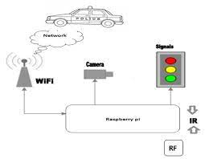
EXISTING SYSTEM BLOCK DIAGRAM

Slide 17
DRAWBACKS OF EXISTING SYSTEM
Need Large Manpower to monitor traffic
Traffic Congestion
Wastage of time

Slide 18
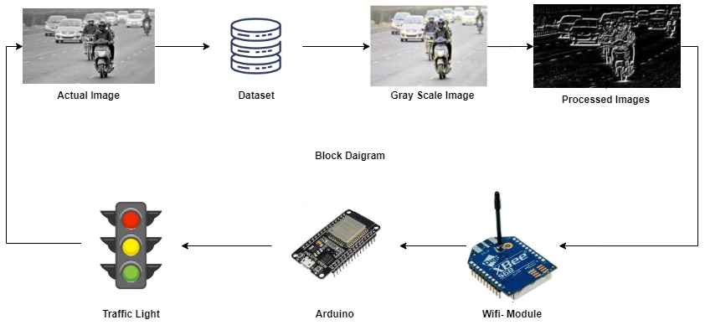
PROPOSED SYSTEM BLOCK DIAGRAM(IOT)

Slide 19
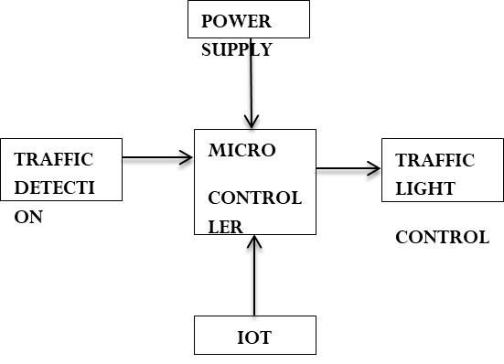
TRAFFIC DETECTION SYSTEM
Dataset
Pre-processing
Model building
classificationn

Slide 20
MODULE DESCRIPTION
Image Acquisition:
The Real time Road Images of dataset acquisition has been used to implement the proposed methods. This method is used to design for extraction of Traffic with accuracy and composed number of stages is including image capturing, edge detection, and classification of Traffic Detection.
Image Pre-Processing:
In this module, we are performing some basic operation on image to get proper image for processing. In this module, we are perform certain operation like gray-scale conversion, filtering, sharpening, smoothing, edging, and image segmentation to get proper and clean image. Preprocessing step enhances the quality of the images by eliminating noise.

Slide 21
MODULE DESCRIPTION
Image Segmentation:
Image Segmentation is an important step in domain of computer vision based on emerging applications including imaging, video surveillance and many more. The image segmentation is a step of processing which is used threshold method to segment the Road image level to binary image.
Feature Extraction:
In this module, we are performing some more operation on segmented image. In this module we will perform feature extraction operation to get all detailed information about Road Traffic image. Feature Extraction and reduction has been playing a vital role for Traffic Detection into their relevant categories in the field of computer vision and machine learning.

Slide 22
MODULE DESCRIPTION
Traffic Classification:
In this module, we are performing classification techniques with help of deep learning algorithm to determine Road Traffic condition. The Road Traffic classification is the final step of the proposed approach that is used to identify the type of Traffic like Low Traffic, Medium Traffic, High Traffic and No Traffic.
Convolutional Neural Network:
The name of “Convolutional Neural Network” performs the mathematical operation called convolution. Convolution is a specialized kind of linear operation. In deep learning, a convolutional neural network (CNN, or ConvNet) is a class of deep neural networks, Convolutional networks are simply neural networks that use convolution in matrix multiplication in at least one of their layers.

Slide 23
RESULTS AND DISCUSSION
The data set is a collection of images of the traffic in the urban from the real world.
From the designed system in Iot the traffic is detected. This is given as the input to the microcontroller and then the traffic light is controlled.
The density of the lanes are detected and the traffic light is controlled in such a way that the lane with high density is moved first. The seconds of the traffic light in the high density area is changed.
The the dataset is taken as the input which contains images and the images are proceesed (Pre-processing).

Slide 24
RESULTS AND DISCUSSION
After the images are pre-processed,the dataset is fit into a machine learning model.
The project is to Detect the traffic in roads using CNN based model from the given images, so the model is trained for the classification of images using Datasets of Road images.
We upload the real time road images so it detect as a Low, Medium, High or No Traffic.
An application is build to detect the traffic in the area.

Slide 25
CONCLUSION
In this study, we used transfer learning to develop a CNN model for automatic Traffic detection using Road images. Transfer learning uses weights from networks previously trained on millions of data. The proposed study implements four different transfer learning models with different optimizers (ADAM, SGD, RMSprop), and extensive experiments were performed on the datasets with the largest number of Road images currently available. For this models, the features are extracted using transfer learning, and three dense layers along with the softmax layer are used for classification purposes.

Slide 26
Snap Shot

Slide 27
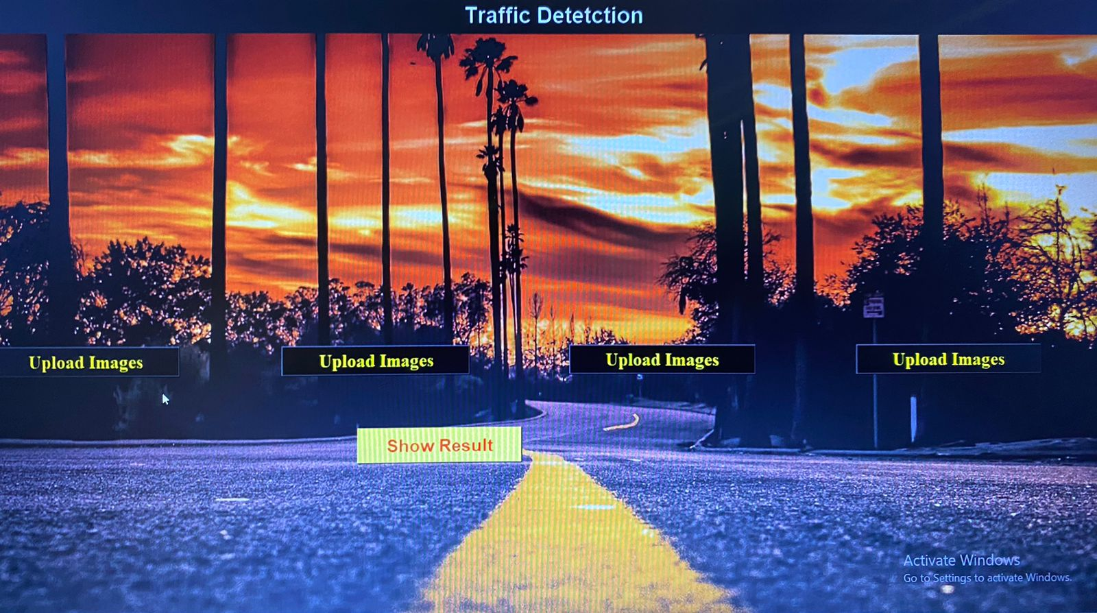
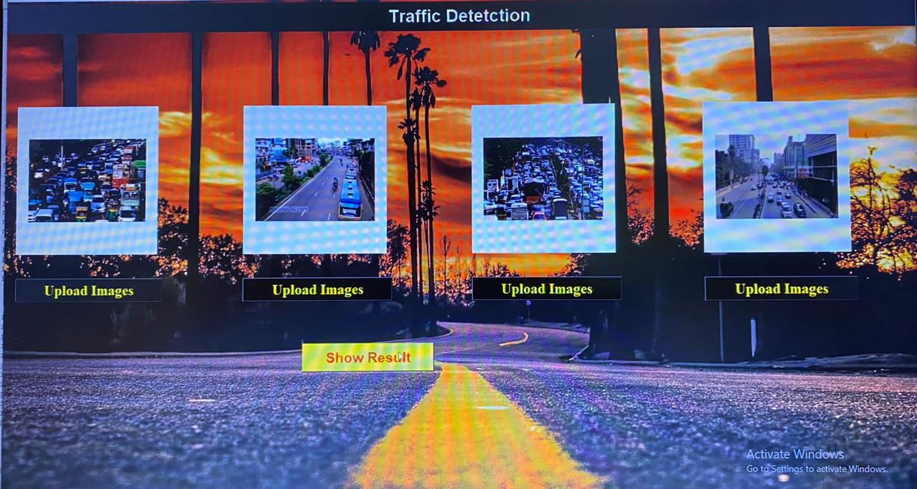

Slide 28
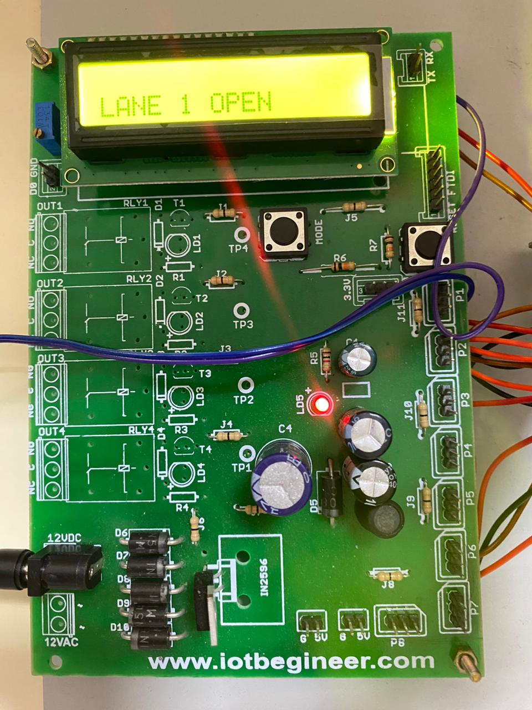
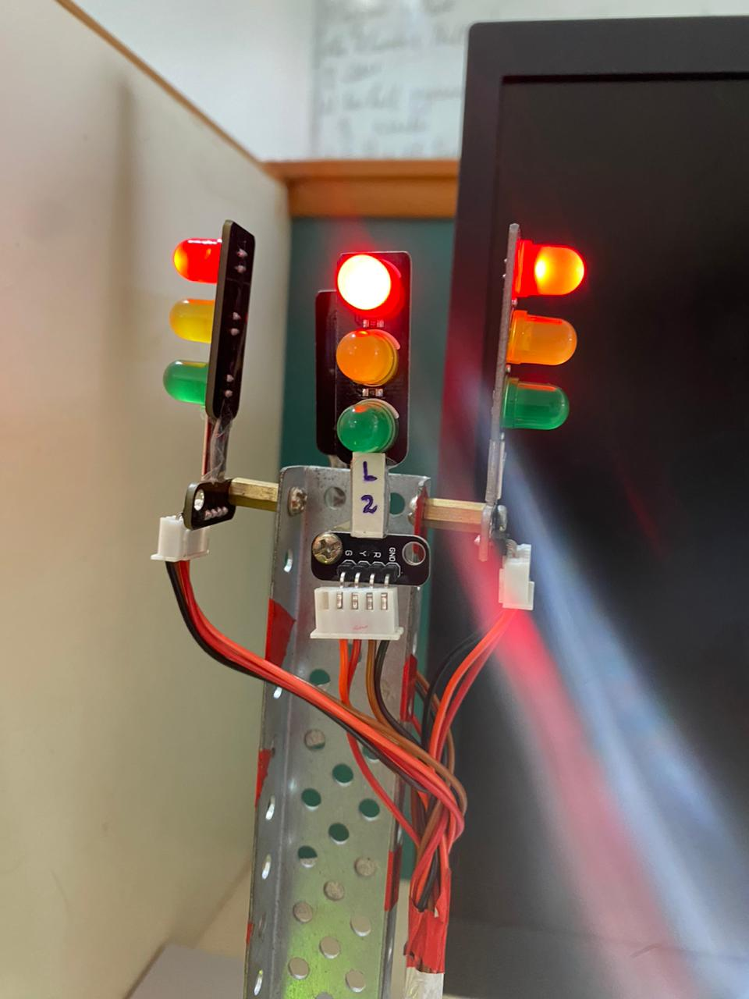
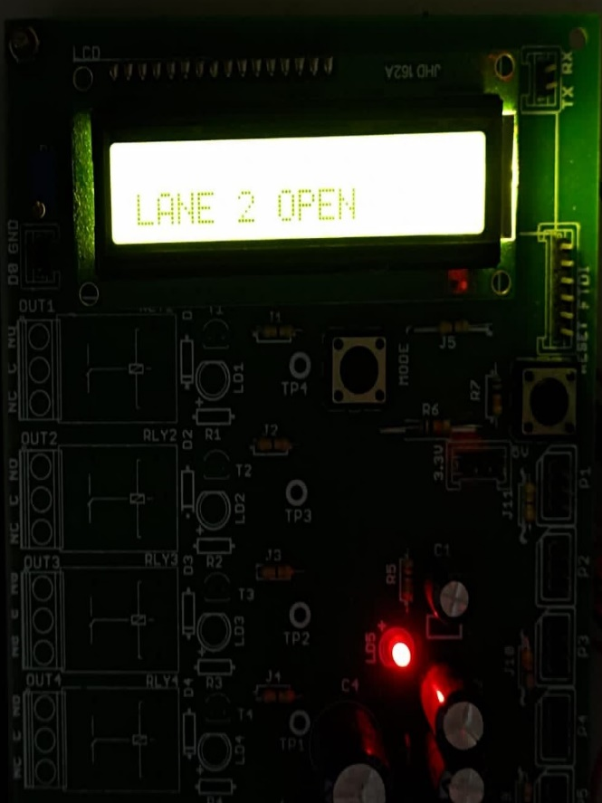

Slide 29
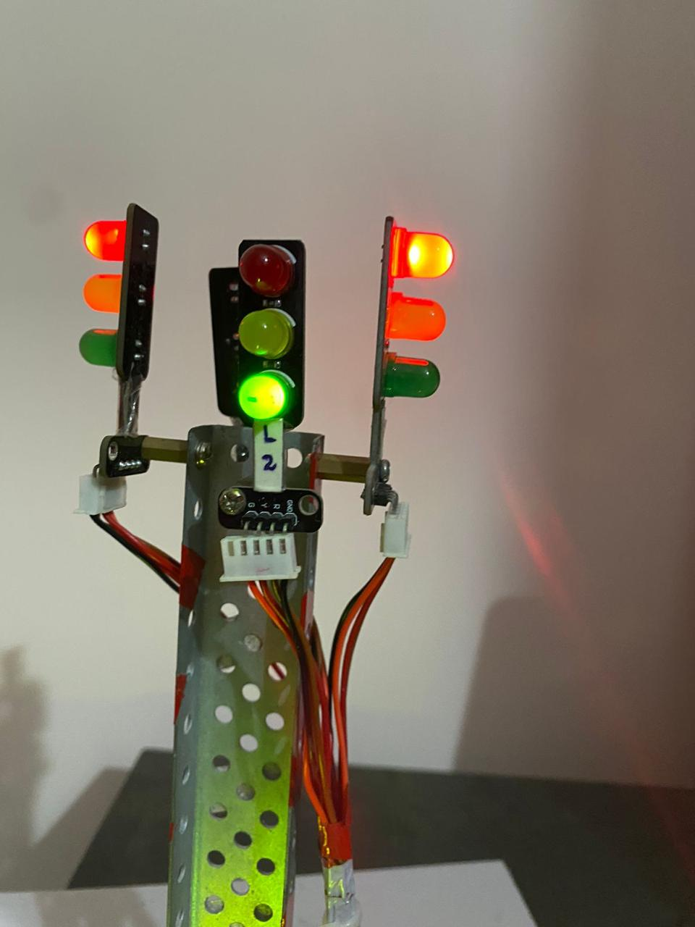
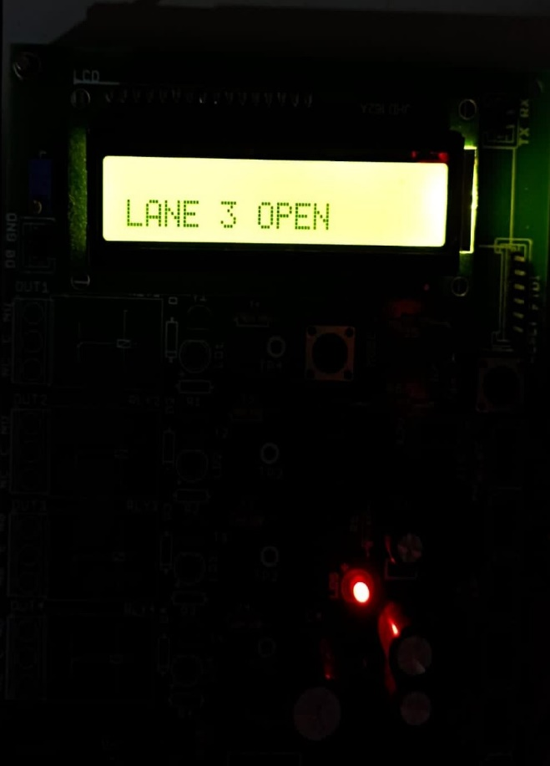
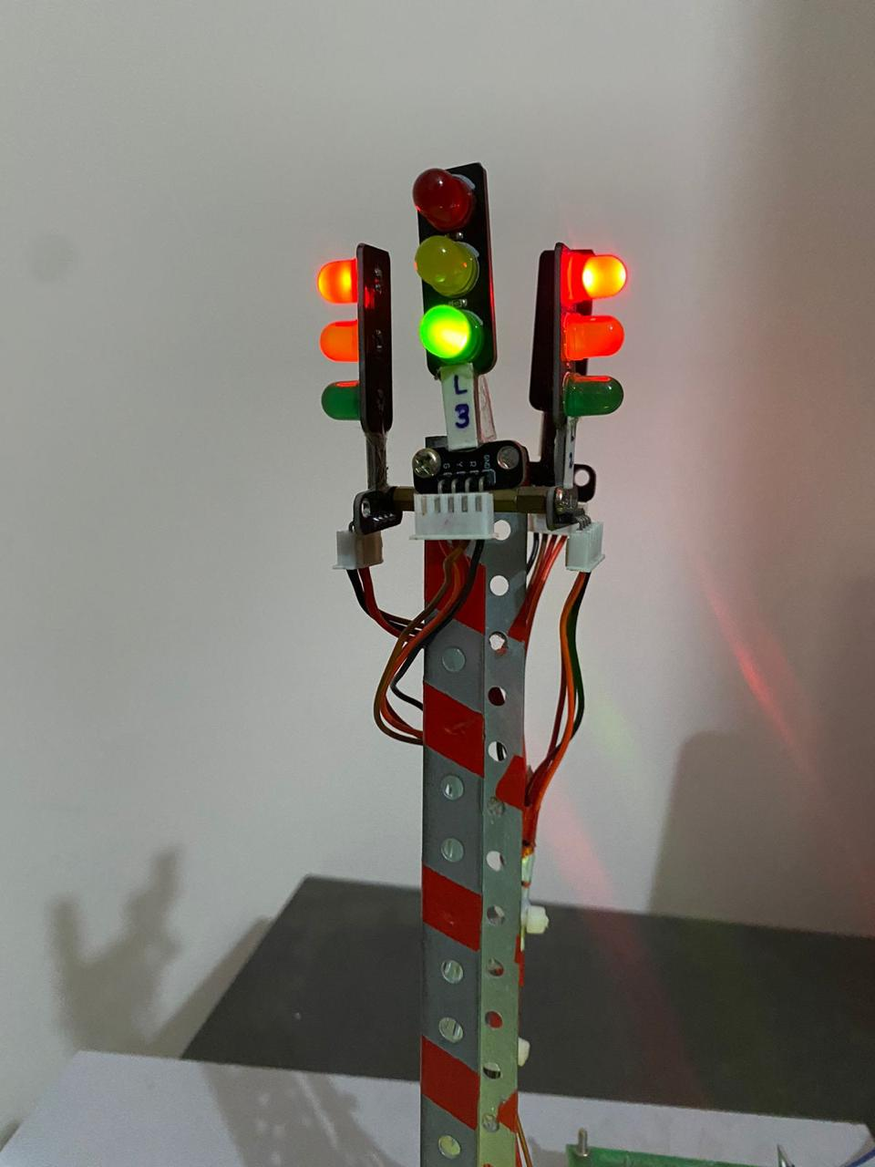

Slide 30
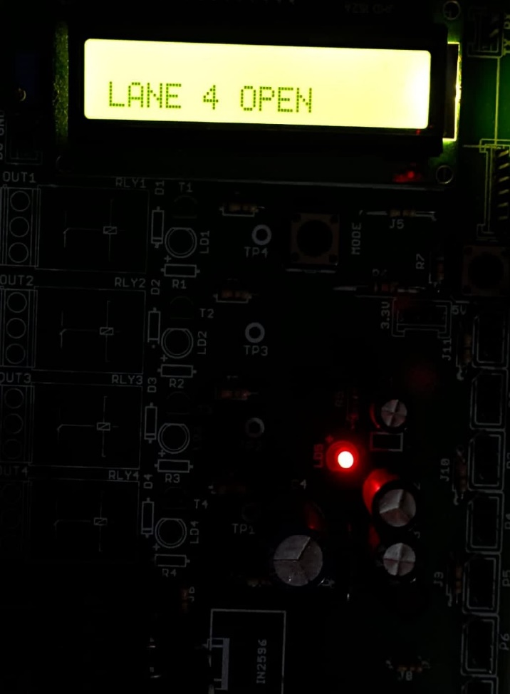
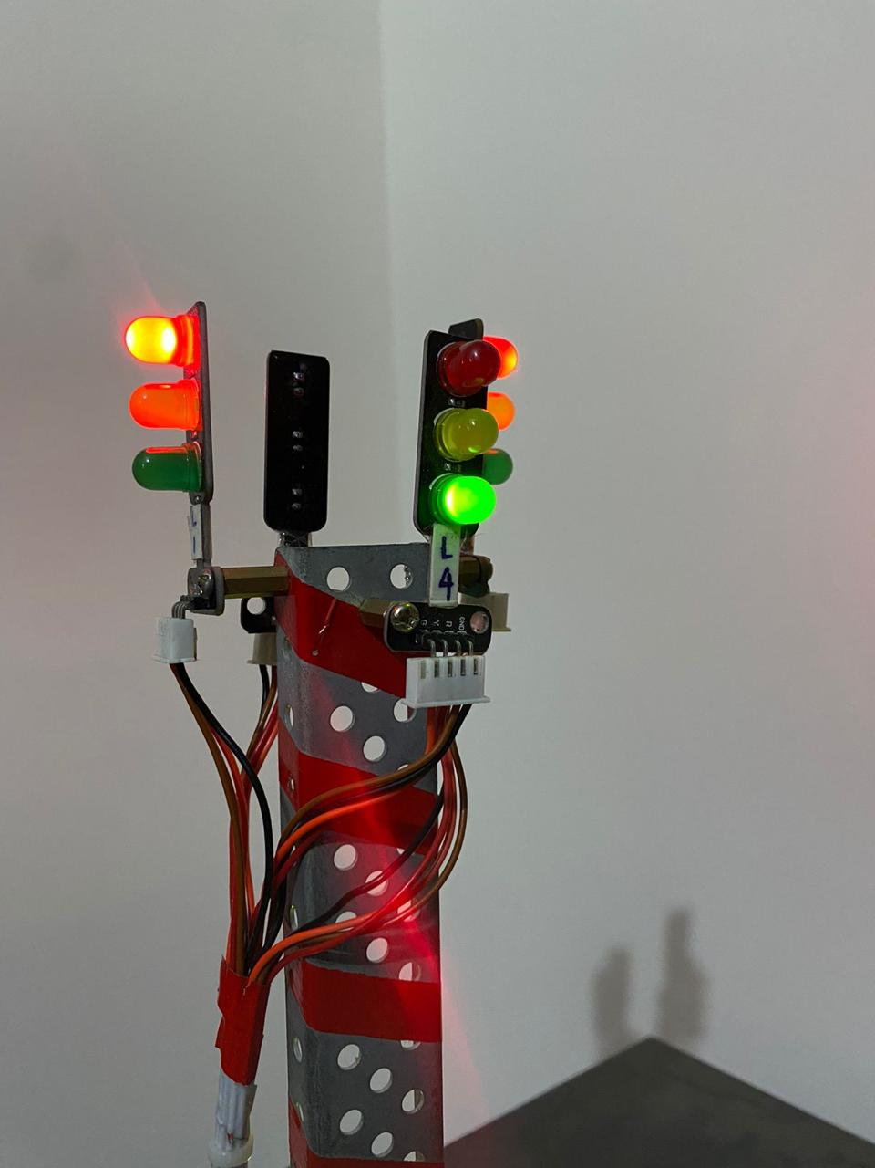

Slide 31
PROJECT CONTEST DETAILS
NAME (ROLLNO) | CONTEST | TITLE | COLLEGE | DATE
R.SAMITHA(19BCS005) R.NIKESH (19BCS093) D.S.TAMILARASAN(19BCS099) | 3rd International conference on Recent Trends in Engineering technology and Management 2023 | Smart Traffic Light Monitoring System using image Processing | Christ The King Engineering College | May 6 & May 7

Slide 32
REFERENCES
Guo, K., Hu, Y., Qian, Z., Liu, H., Zhang, K., Sun, Y., & Yin, B. (2020). “Optimized graph convolution recurrent neural network for traffic prediction.” IEEE Transactions on Intelligent Transportation Systems, 22(2), 1138-1149.
Xu, H., & Jiang, C. (2020). “Deep belief network-based support vector regression method for traffic flow forecasting. Neural Computing and Applications”, 32(7), 2027-2036.
Zhao, F., Zeng, G. Q., & Lu, K. D. (2019). EnLSTM-WPEO:“Short-term TFP by ensemble LSTM, NNCT weight integration, and population extremal optimization. IEEE Transactions on Vehicular Technology”, 69(1), 101-113.

Slide 33
REFERENCES
Peng, H., Du, B., Liu, M., Liu, M., Ji, S., Wang, S., ... & He, L. (2021). “Dynamic graph convolutional network for long-term TFP with reinforcement learning”. Information Sciences, 578, (1) 401-416.
B. Hussain, M. K. Afzal, S. Ahmad and A. M. Mostafa. (2021) .“Intelligent TFP Using Optimized GRU Model” IEEE Access, 9(1), 100736-100746.
Ma, Q., Huang, G. H., & Ullah, S. (2020). “A Multi-Parameter Chaotic Fusion Approach for Traffic Flow Forecasting.” IEEE Access, 8(1), 222774-222781.

Slide 34
REFERENCES
Wang, Z., Su, X., & Ding, Z. (2020). “Long-term traffic prediction based on lstm encoder-decoder architecture”.IEEE Transactions on Intelligent Transportation Systems, 22(10), 6561-6571.
Kumar, B. R., Chikkakrishna, N. K., & Tallam, T. (2020). “Short Term Predictions of Traffic Flow Characteristics using ML Techniques”. In 2020 4th International Conference on Electronics, Communication and Aerospace Technology (ICECA) 4(1),1504-1508.
Qu, W., Li, J., Yang, L., Li, D., Liu, S., Zhao, Q., & Qi, Y. (2020). “Short-term intersection Traffic flow forecasting”. Sustainability, 12(19), 1-13.

Slide 35
REFERENCES
Jia, T., & Yan, P. (2020). “Predicting citywide road traffic flow using deep spatiotemporal neural networks”. IEEE Transactions on Intelligent Transportation Systems, 22(5), 3101-3111.
S. Ren, K. He, R. Girshick and J. Sun, "Faster R-CNN: Towards Real-Time Object Detection with Region Proposal Networks", IEEE Trans. Pattern Anal. Mach. Intell., vol. 39, no. 6, pp. 1137-1149, 2017.
J. Redmon, S. Divvala, R. Girshick and A. Farhadi,” You Only Look Once: Unified Real-Time Object Detection”, 2015.

Slide 36
REFERENCES
V. Badrinarayanan, A. Kendall and R. Cipolla, "SegNet: A Deep Convolutional Encoder-Decoder Architecture for Image Segmentation", IEEE Trans. Pattern Anal. Mach. Intell., vol. 39, no. 12, pp. 2481-2495, 2017.
Y. Zhou, L. Liu, L. Shao and M. Mellor, "DAVE: A unified framework for fast vehicle detection and annotation", Lect. Notes Comput. Sci. (including Subser. Lect. Notes Artif. Intell. Lect. Notes Bioinformatics), vol. 9906 LNCS, pp. 278-293, 2016.
Ms. Saili Shinde, Prof. Sheetal Jagtap, Vishwakarma Institute Of Technology, “Intelligent traffic management system”:a Review, IJIRST 2016.

Slide 37
Thank You

